Slide 1
Redshift

Slide 2
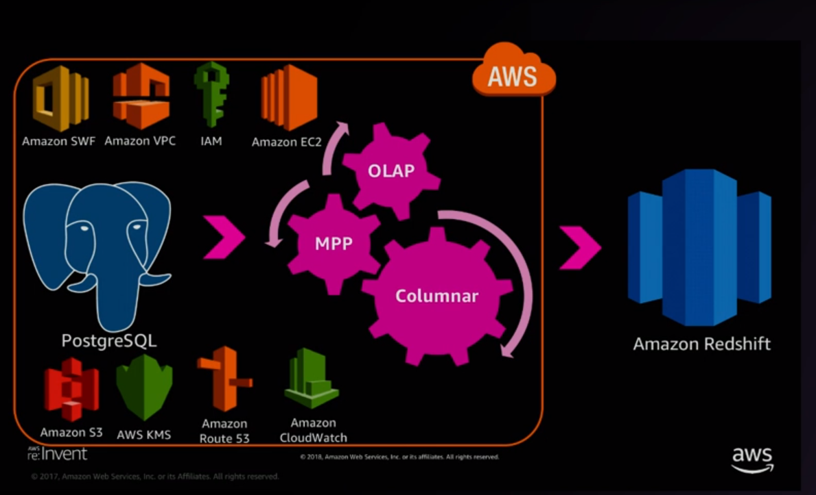
What is RedshiftDB

Slide 3
Redshift is launched on Valentines day Feb 14 2013
Redshift supports both JDBC and ODBC drivers. You can also use open source postgres drivers
Leader Node → handles the metadata (just like pgcatalo)
Behind each leader node we may have 2-128 compute nodes (data is spread in compute nodes)
Each query gets executed in parallel in all available compute nodes
Massively parallel shared nothing columnar architecture
Redshift automatically backups data asynchronously in the background and synchronises to s3

Slide 4
If you want to restore, that happens to s3 as well.
AWS Redshift Spectrum → middleman between s3 and compute node
If our data lake (paraquet files) resides in s3 and you can expose those paraquet files in redshift as external tables and query them . That query gets pushed onto this compute layer and u get result.
We can even join tables in s3 with local redshift tables.

Slide 5
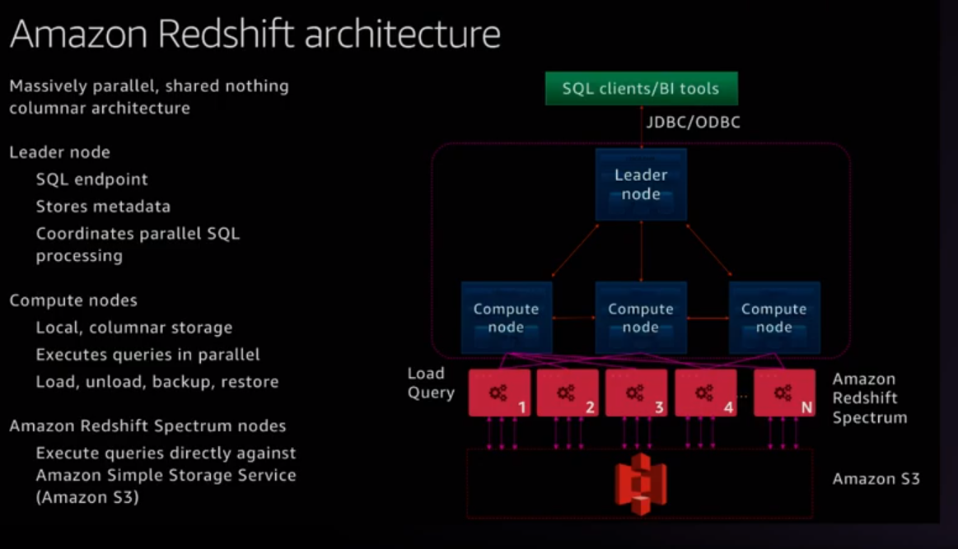

Slide 6
Terminology and concepts
Redshift uses a columnar architecture for storing data on disk
Goal : reduce I/O for analytics queries

Slide 7
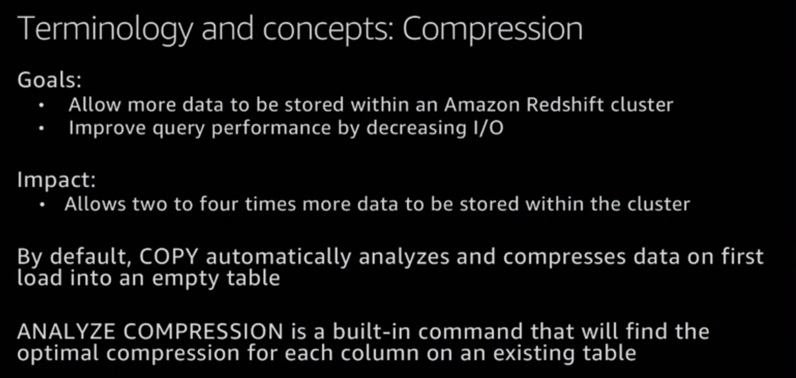

Slide 8
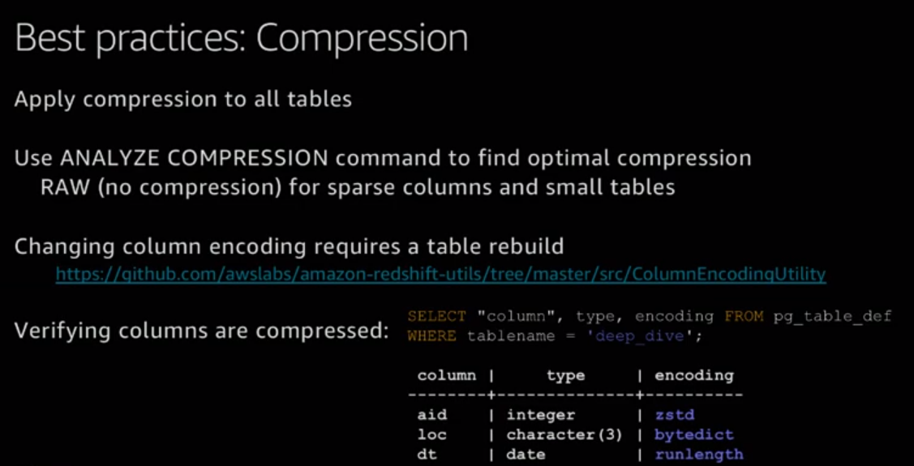

Slide 9
Analyze compression can be used for specific columns as well as total columns in table
analyze compression tablename;
analyze compression sales(qtysold, commission, saletime);

Slide 10
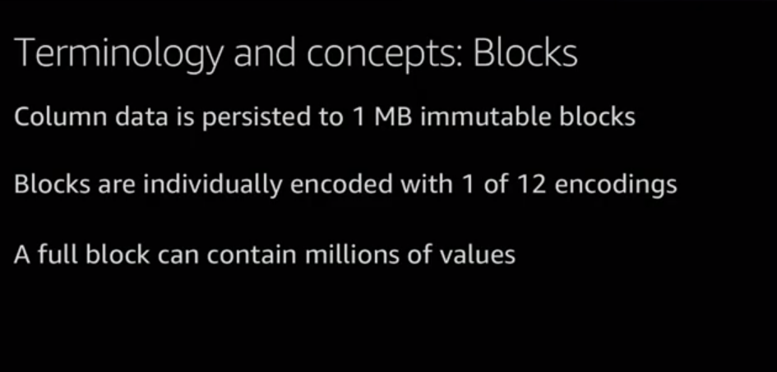

Slide 11
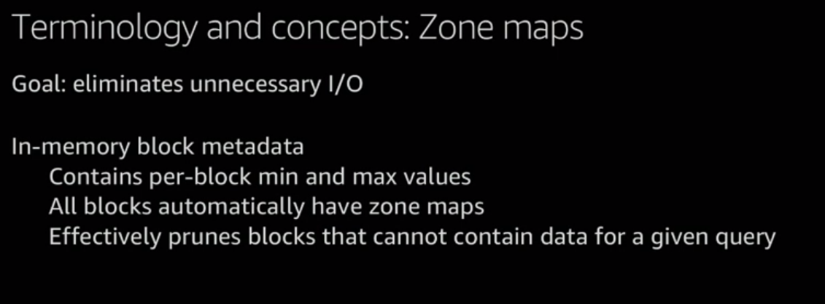

Slide 12
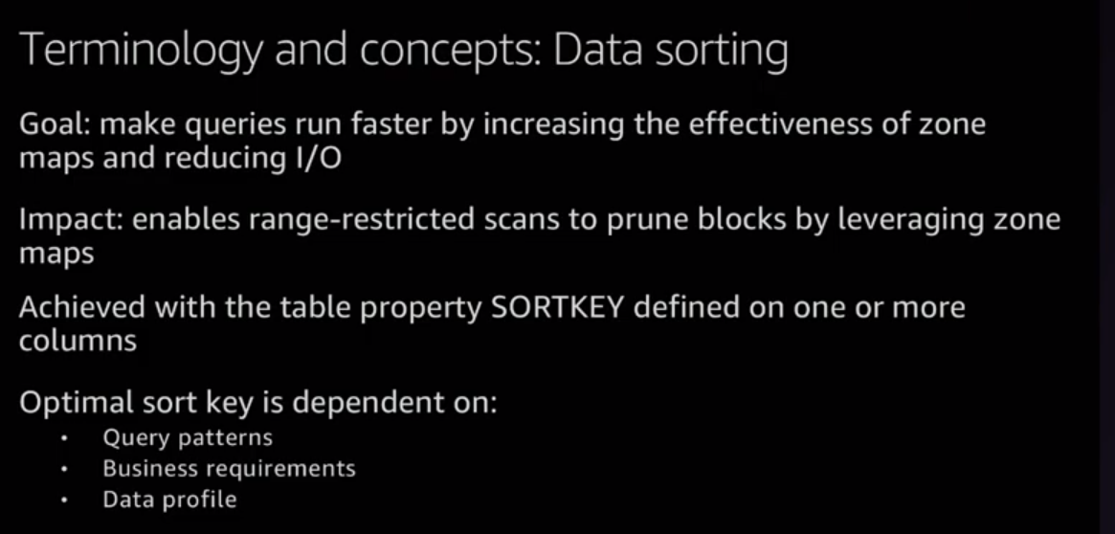

Slide 13
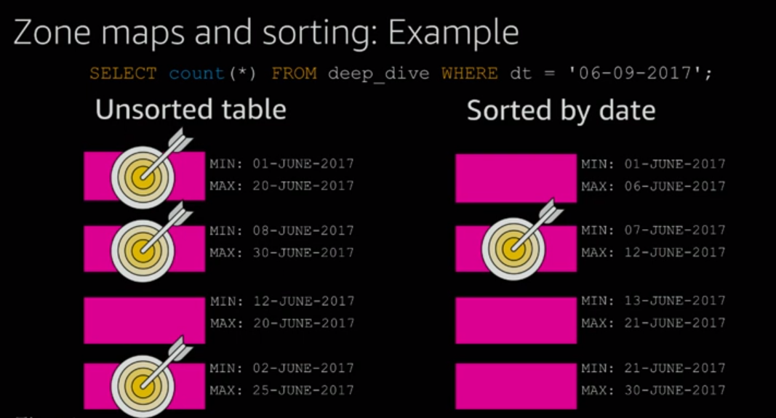

Slide 14
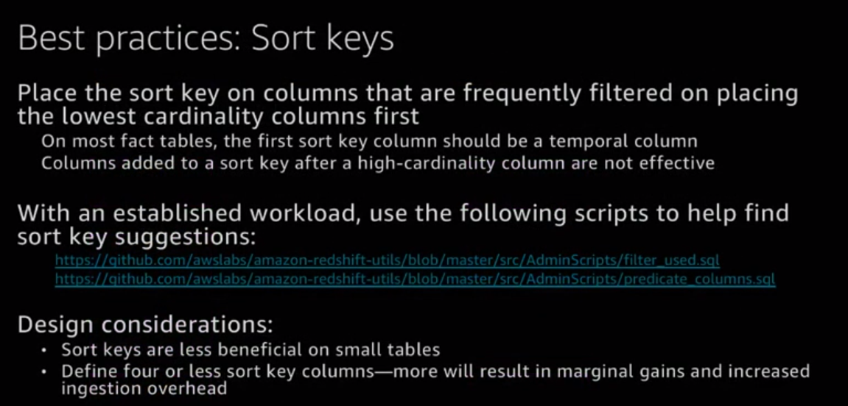

Slide 15
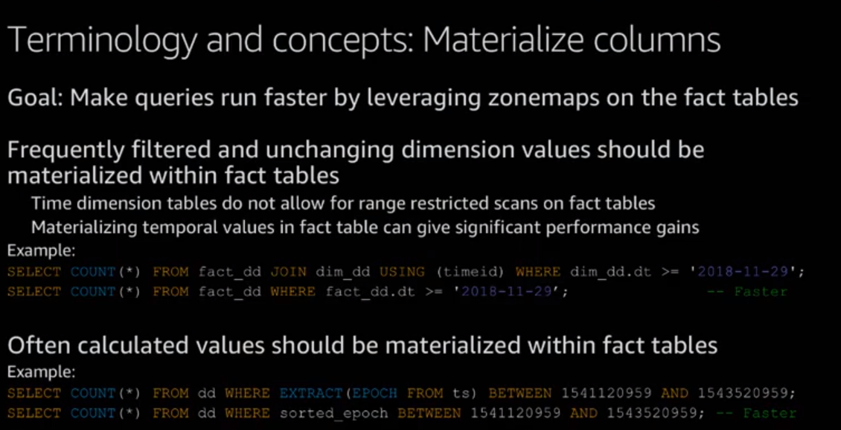

Slide 16
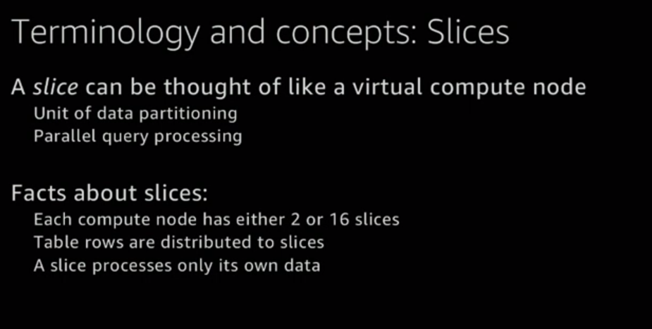

Slide 17
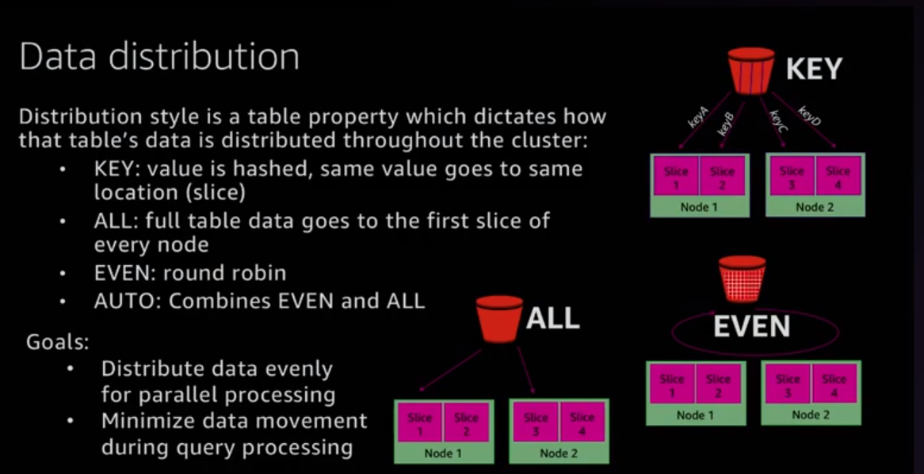

Slide 18
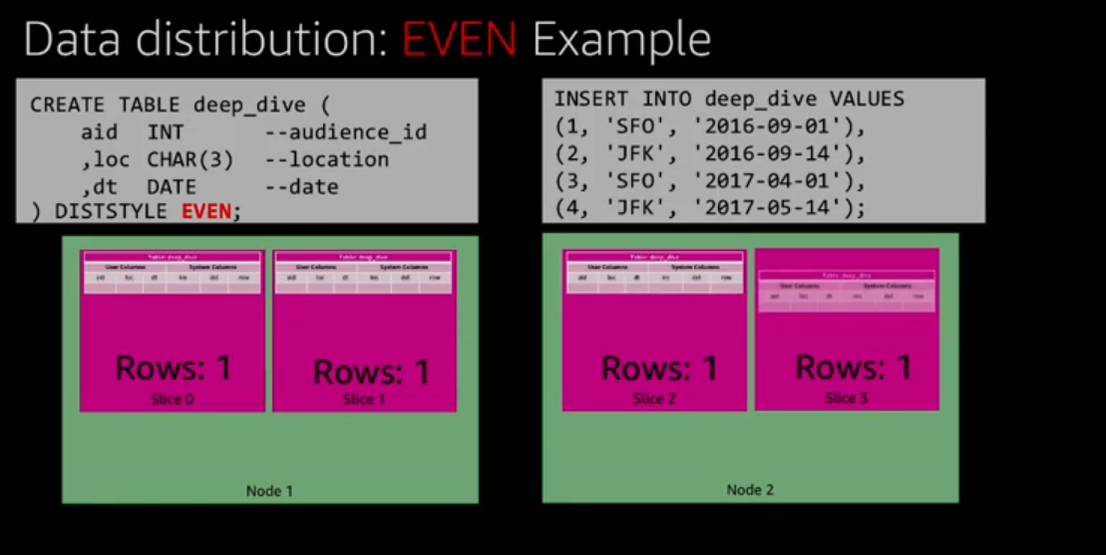

Slide 19
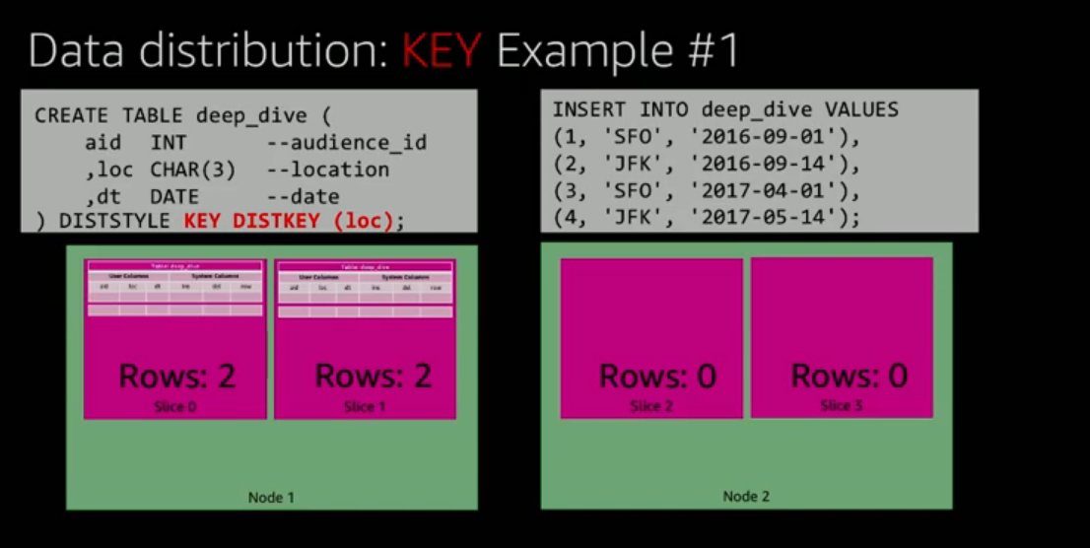

Slide 20
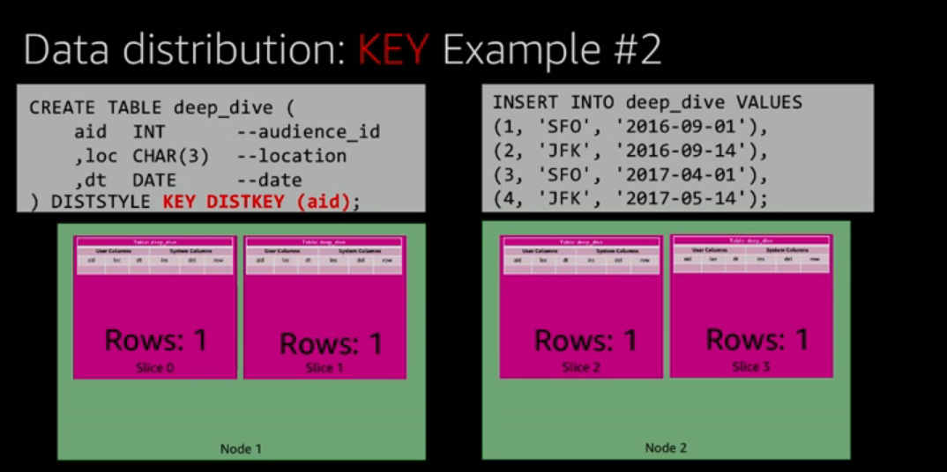

Slide 21
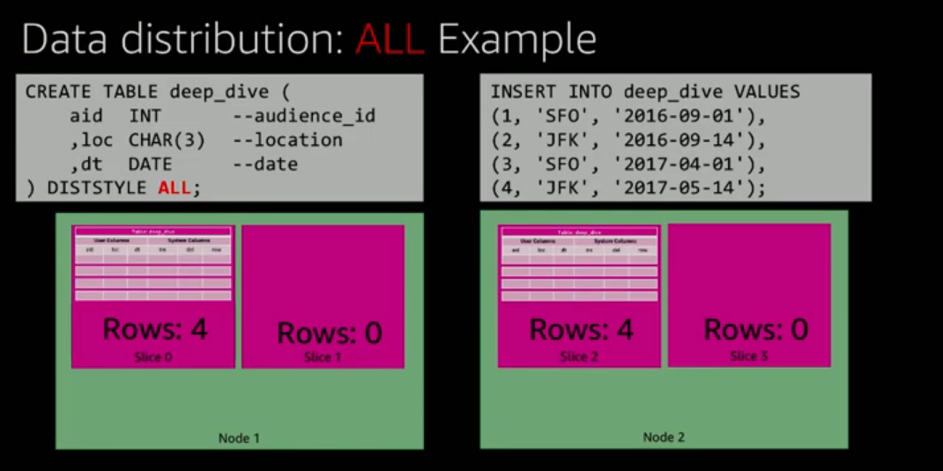

Slide 22
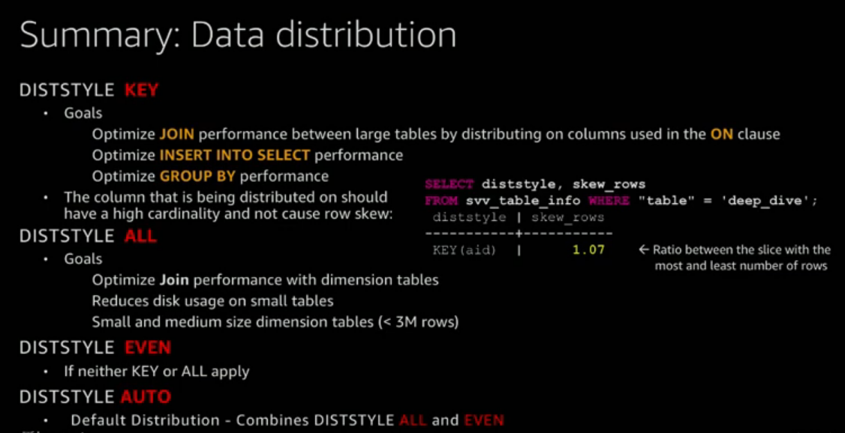

Slide 23
For DISTSTYLE KEY : If we are able to distribute the table on the column used in on clause in a join then that makes the data (rows) sit in the same slice and the performance will be faster
One way to check on the Distribution : select * from svv_table_info where table = ‘tablename’ → has a column named skew_rows and it’s value should be around 1 or less than 1.3.
Insert scripts from one table to other will have same distribution key so that operation will be significantly faster

Slide 24
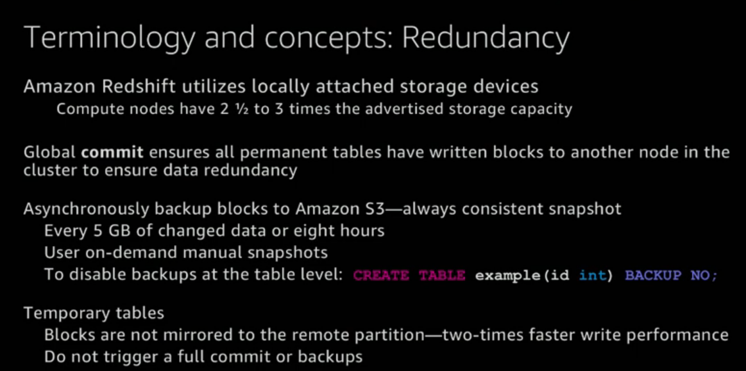

Slide 25
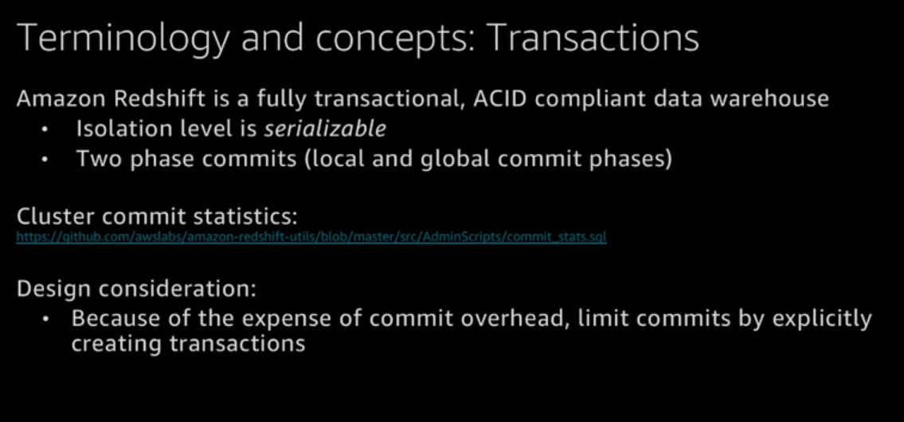

Slide 26
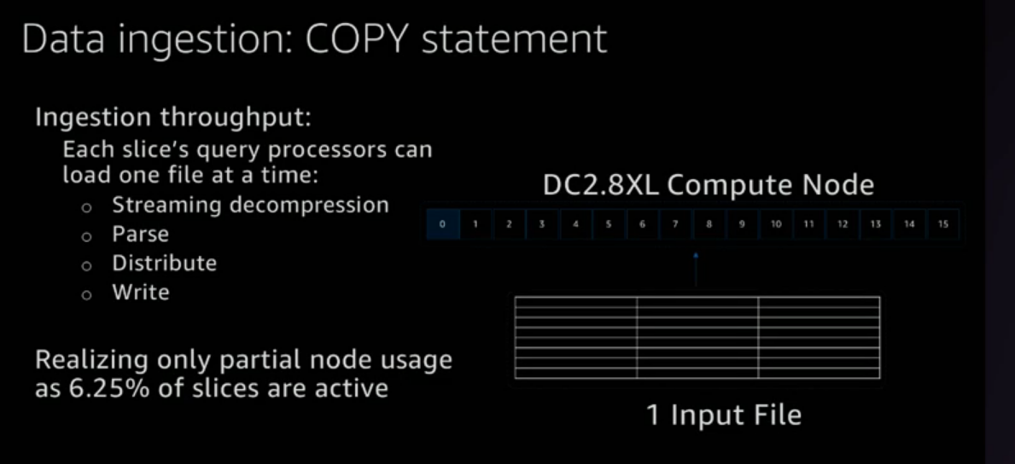

Slide 27
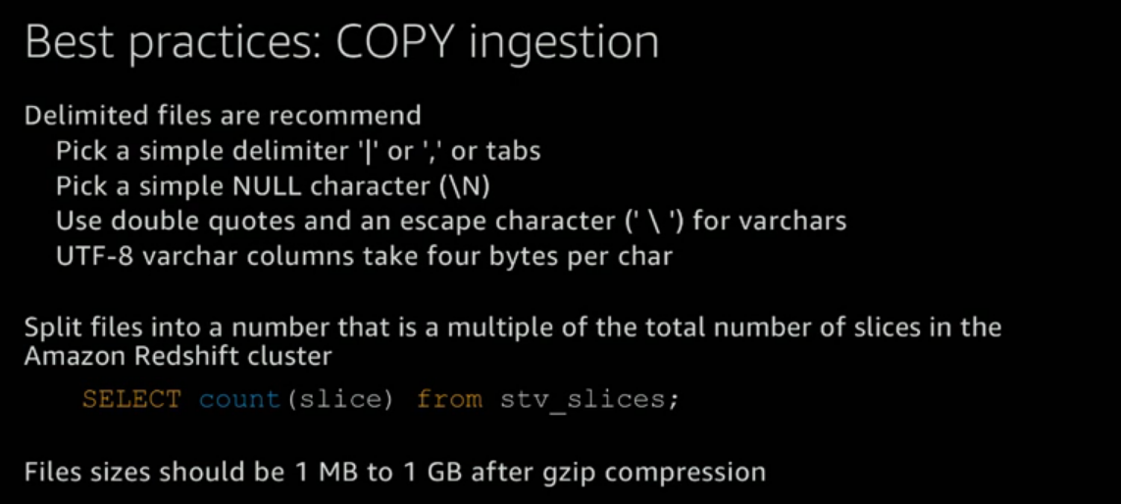

Slide 28
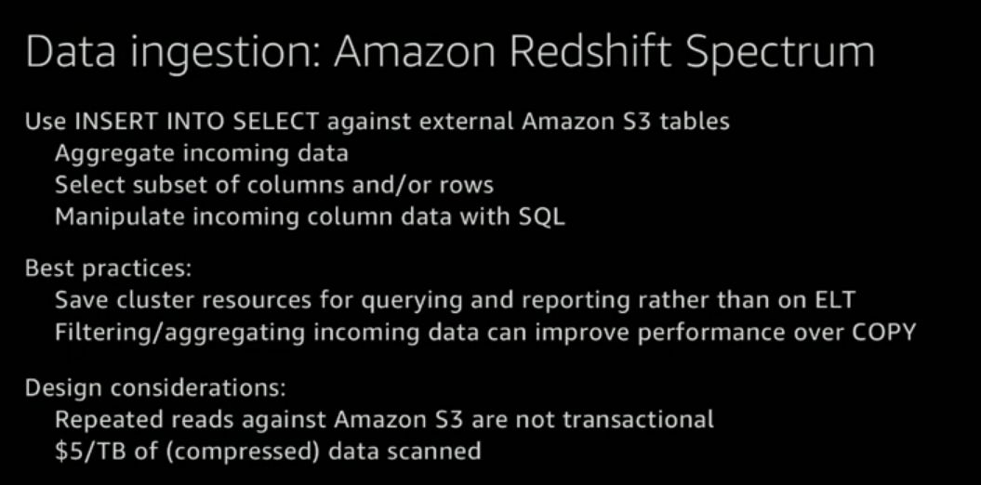

Slide 29
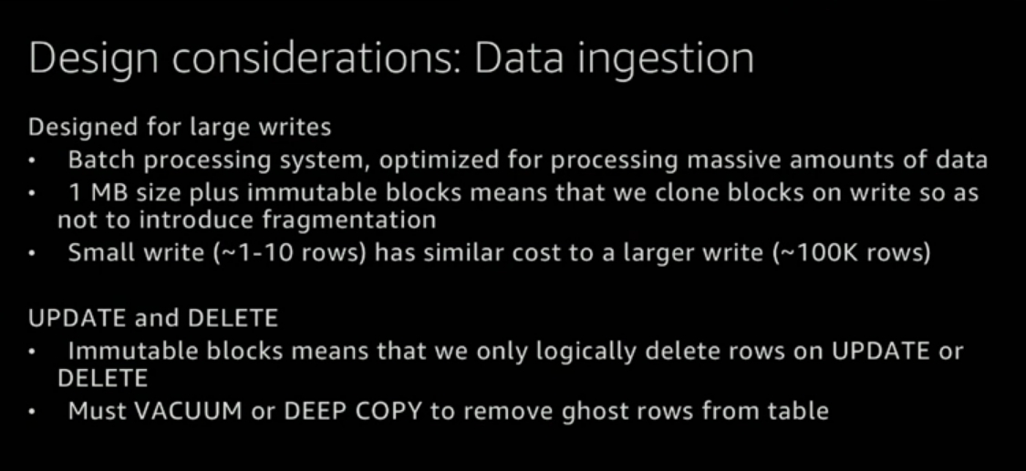

Slide 30
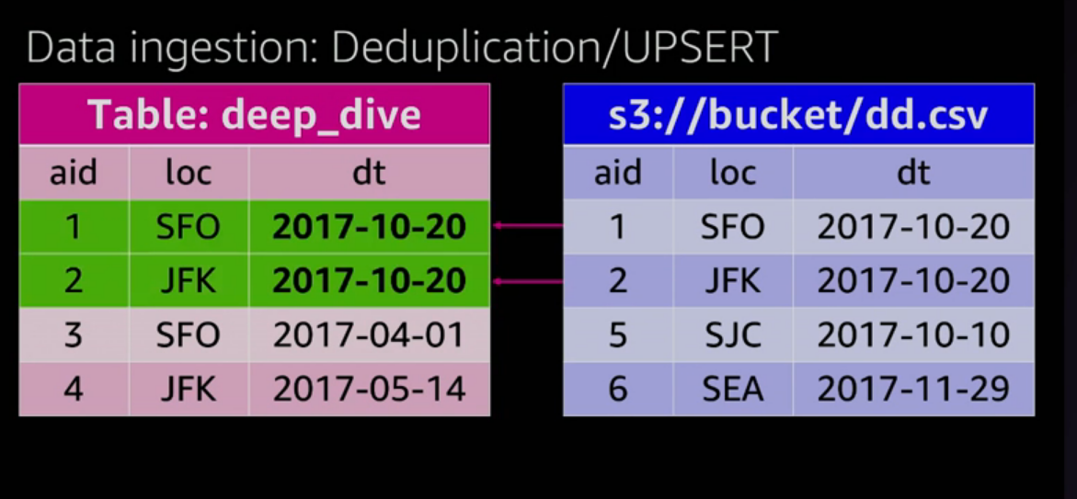

Slide 31
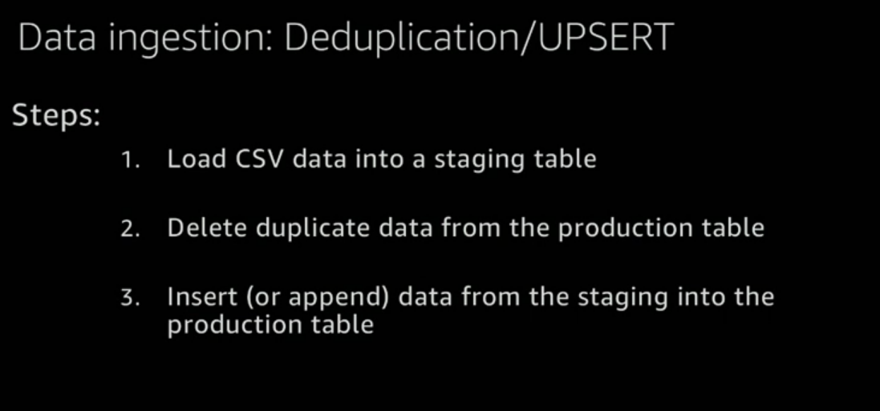

Slide 32
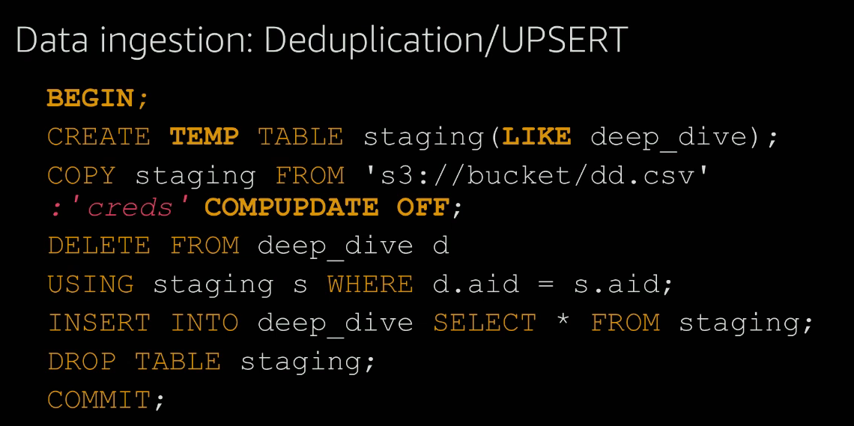

Slide 33
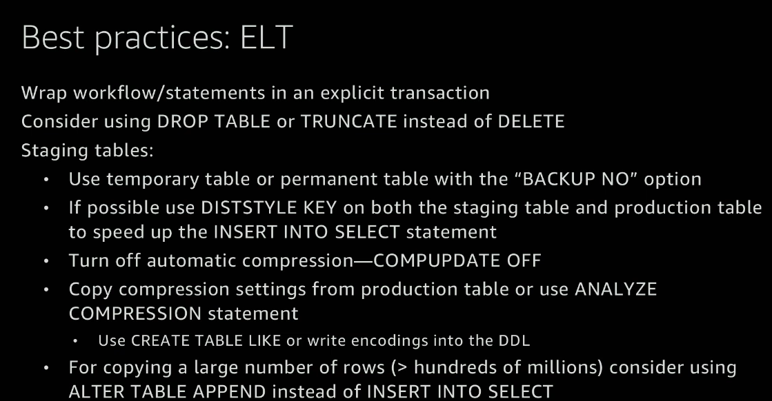

Slide 34
CREATE [ [LOCAL ] { TEMPORARY | TEMP } ] TABLE
[ IF NOT EXISTS ] table_name
( { column_name data_type [column_attributes] [ column_constraints ]
| table_constraints
| LIKE parent_table [ { INCLUDING | EXCLUDING } DEFAULTS ] }
[, ... ] )
[ BACKUP { YES | NO } ]
[table_attribute]
where column_attributes are:
[ DEFAULT default_expr ]
[ IDENTITY ( seed, step ) ]
[ ENCODE encoding ]
[ DISTKEY ]
[ SORTKEY ]
and column_constraints are:
[ { NOT NULL | NULL } ]
[ { UNIQUE | PRIMARY KEY } ]
[ REFERENCES reftable [ ( refcolumn ) ] ]
and table_constraints are:
[ UNIQUE ( column_name [, ... ] ) ]
[ PRIMARY KEY ( column_name [, ... ] ) ]
[ FOREIGN KEY (column_name [, ... ] ) REFERENCES reftable [ ( refcolumn ) ]
and table_attributes are:
[ DISTSTYLE { EVEN | KEY | ALL } ]
[ DISTKEY ( column_name ) ]
[ [COMPOUND | INTERLEAVED ] SORTKEY ( column_name [, ...] ) ]
https://docs.aws.amazon.com/redshift/latest/dg/r_CREATE_TABLE_NEW.html?shortFooter=true → for more details

Slide 35
Redshift Snapshots
https://docs.aws.amazon.com/redshift/latest/mgmt/working-with-snapshots.html
Automated Snapshots
Manual Snapshots

Slide 36
Automated Snapshots
When automated snapshots are enabled for a cluster, Amazon Redshift periodically takes snapshots of that cluster, usually every eight hours or following every 5 GB per node of data changes, or whichever comes first.
Automated snapshots are enabled by default when you create a cluster.
These snapshots are deleted at the end of a retention period. The default retention period is one day, but you can modify it by using the Amazon Redshift console or programmatically by using the Amazon Redshift API or CLI.
To disable automated snapshots, set the retention period to zero. If you disable automated snapshots, Amazon Redshift stops taking snapshots and deletes any existing automated snapshots for the cluster.

Slide 37
Only Amazon Redshift can delete an automated snapshot; you cannot delete them manually. Amazon Redshift deletes automated snapshots at the end of a snapshot’s retention period, when you disable automated snapshots for the cluster, or when you delete the cluster.
Amazon Redshift retains the latest automated snapshot until you disable automated snapshots or delete the cluster.
If you want to keep an automated snapshot for a longer period, you can create a copy of it as a manual snapshot.
The automated snapshot is retained until the end of the retention period, but the corresponding manual snapshot is retained until you manually delete it or until the end of the retention period.

Slide 38
Manual Snapshots
You can take a manual snapshot any time. By default, manual snapshots are retained indefinitely, even after you delete your cluster. You can specify the retention period when you create a manual snapshot, or you can change the retention period by modifying the snapshot.
If a snapshot is deleted, you can't start any new operations that reference that snapshot. However, if a restore operation is in progress, that restore operation will run to completion.
Amazon Redshift has a quota that limits the total number of manual snapshots that you can create; this quota is per AWS account per region.

Slide 39
Managing snapshot storage
Because snapshots accrue storage charges, it’s important that you delete them when you no longer need them.
Amazon Redshift deletes automatic and manual snapshots at the end of the snapshot retention period.
You can also delete manual snapshots using the AWS Management Console or with the batch-delete-snapshots CLI command.

Slide 40
Excluding Tables From Snapshots
By default, all user-defined permanent tables are included in snapshots. If a table, such as a staging table, doesn't need to be backed up, you can significantly reduce the time needed to create snapshots and restore from snapshots.
You also reduce storage space on Amazon S3 by using a no-backup table.
To create a no-backup table, include the BACKUP NO parameter when you create the table.

Slide 41
Copying Snapshots to Another Region
You can configure Amazon Redshift to automatically copy snapshots (automated or manual) for a cluster to another region.
When a snapshot is created in the cluster’s primary region, it will be copied to a secondary region.
these are known respectively as the source region and destination region.
By storing a copy of your snapshots in another region, you have the ability to restore your cluster from recent data if anything affects the primary region.
You can configure your cluster to copy snapshots to only one destination region at a time.

Slide 42
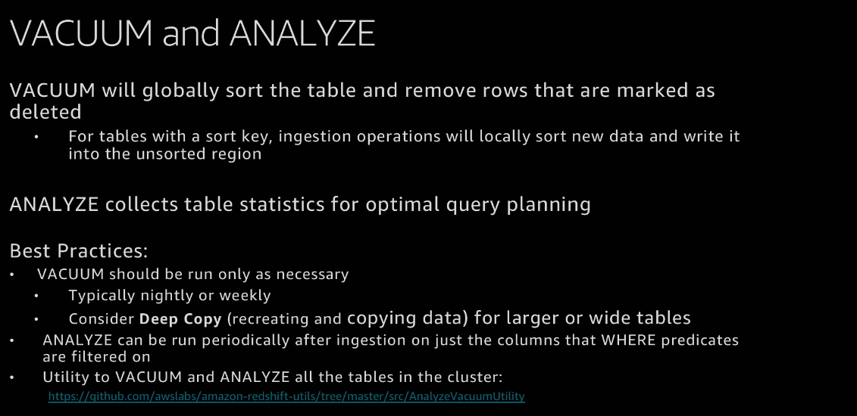

Slide 43
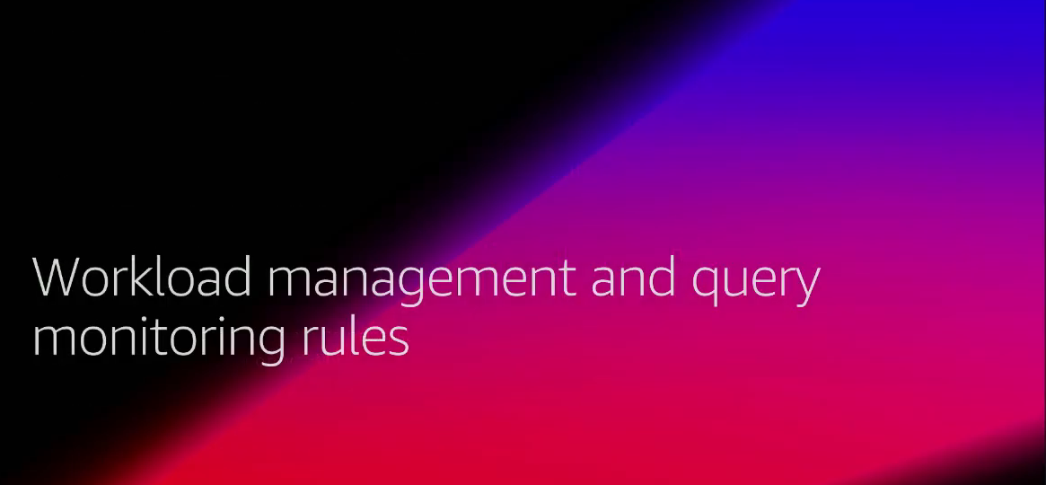

Slide 44
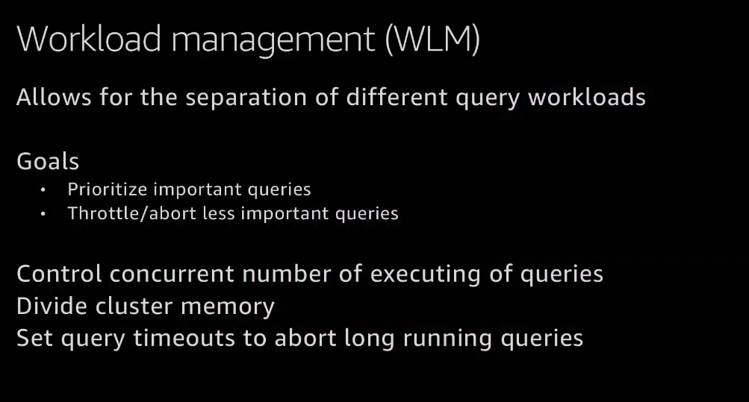

Slide 45
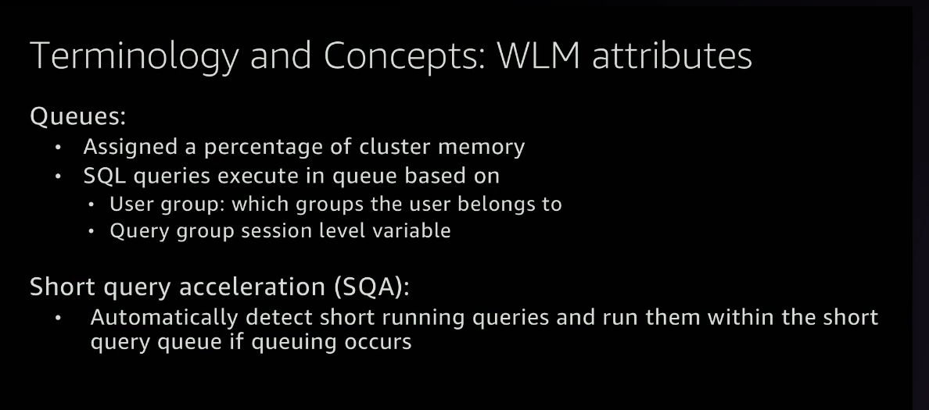

Slide 46
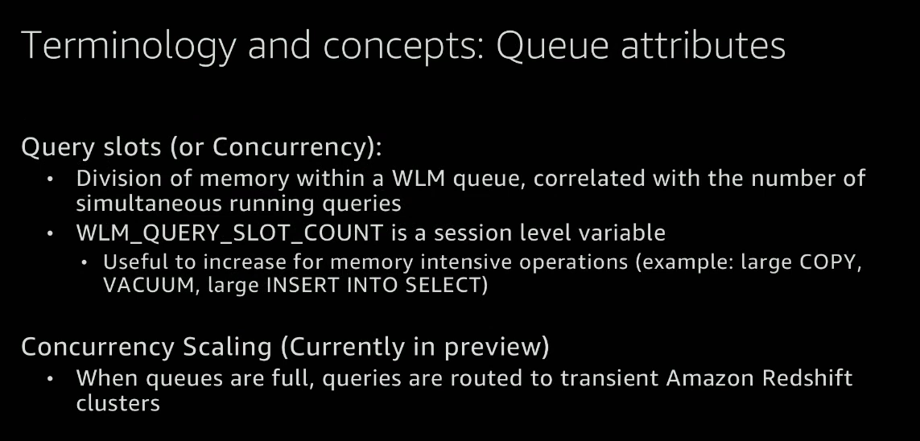

Slide 47
Concurrency scaling is fully managed and all we have to do is opt it.
It is a new release as of Nov 30 2K18.
This is just a drop down where when we opt the queries are routed to secondary clusters (or transient clusters) to speed up the process.
Transient clusters are just temporary clusters just for the time being to finish up the queue and they vanish once the queue no longer needs them.

Slide 48
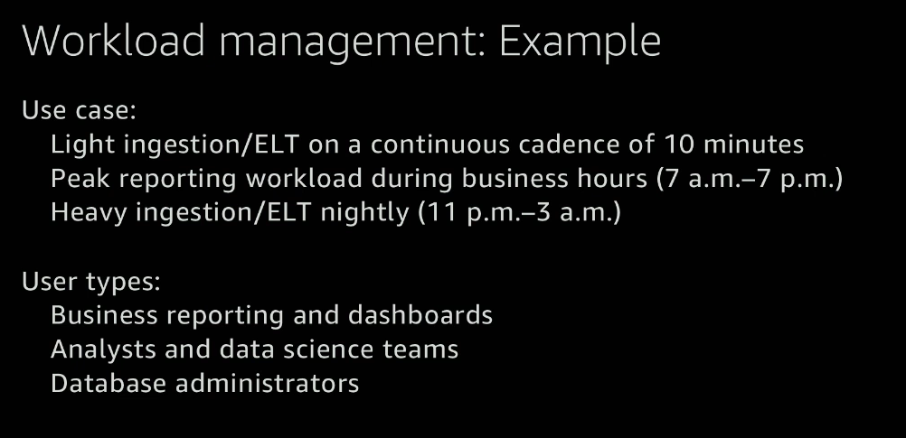

Slide 49
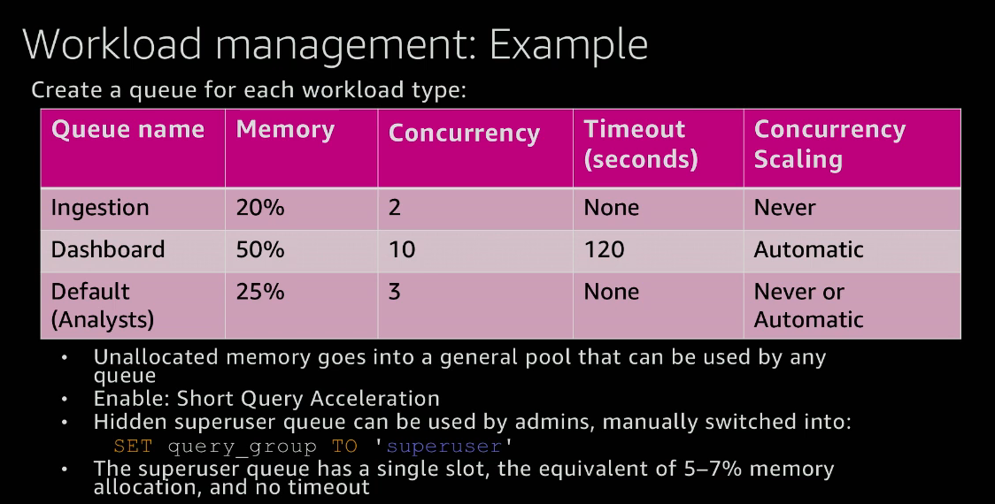

Slide 50
Observation : we left out that 5% of memory on purpose so that it can be used by queues as first come first serve basis.
We usually enable short query acceleration for that unallocated memory.

Slide 51
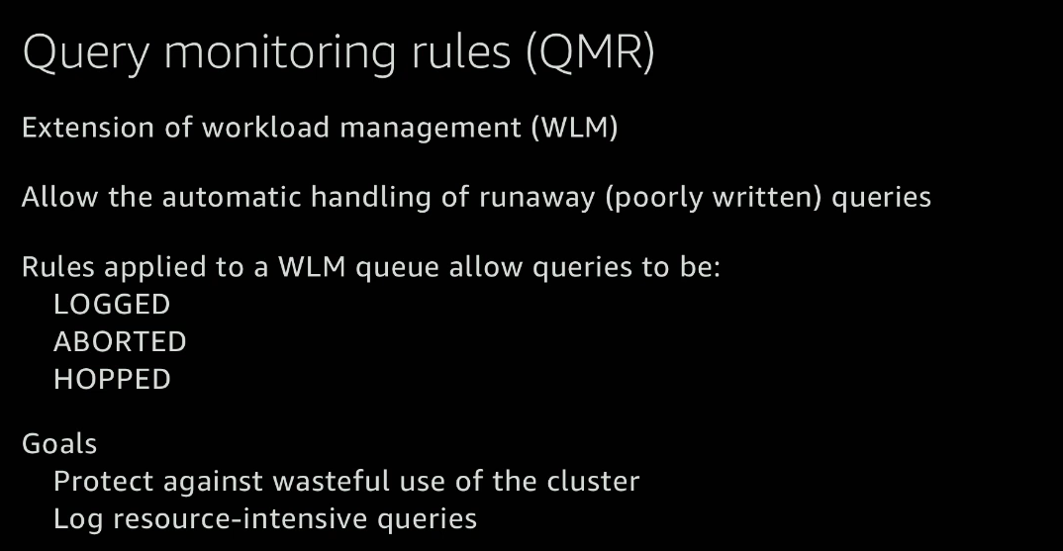

Slide 52
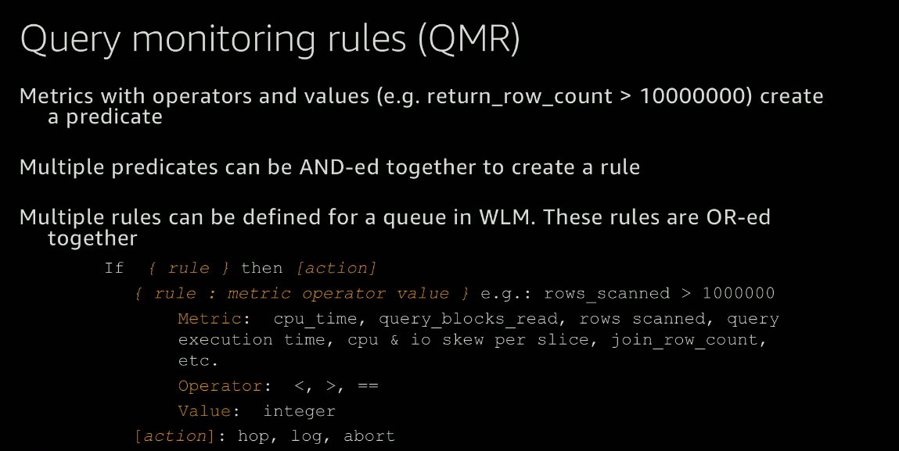

Slide 53
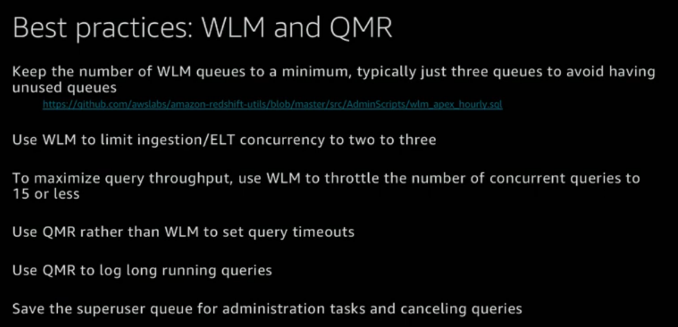

Slide 54
We can maximise no of concurrent queries (i.e. concurrency/no of slots in a cluster) to 50 but in that case each slot will occupy 2% of the memory and every query will get 2% and you might end up with whole bunch of queries that start filling the disk .
So ideal case we can make it to 15 but many customers of AWS make it between 12 - 18

Slide 55
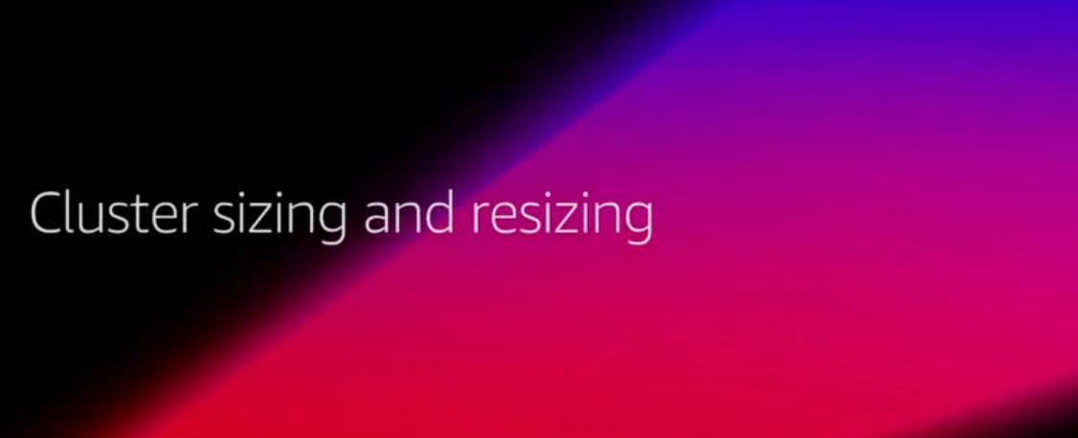

Slide 56
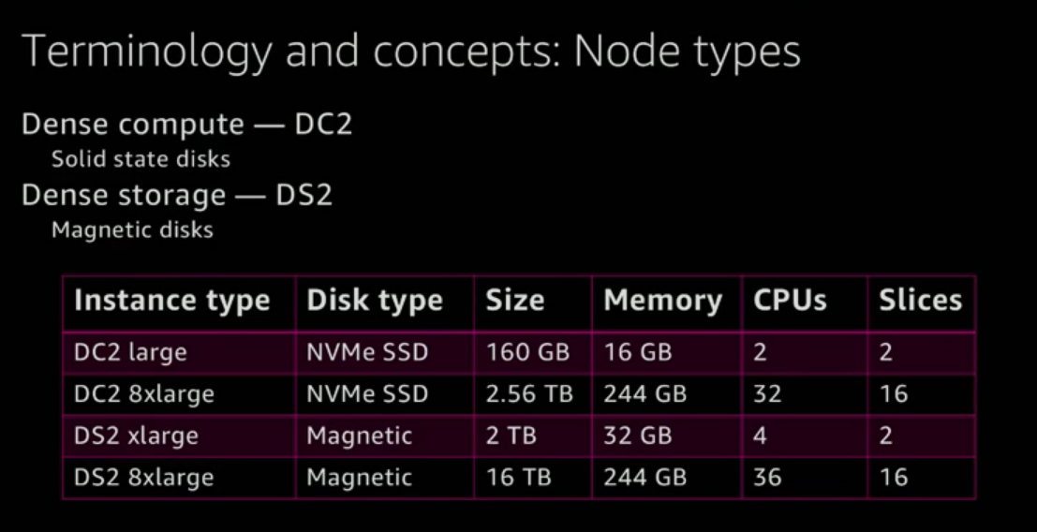

Slide 57
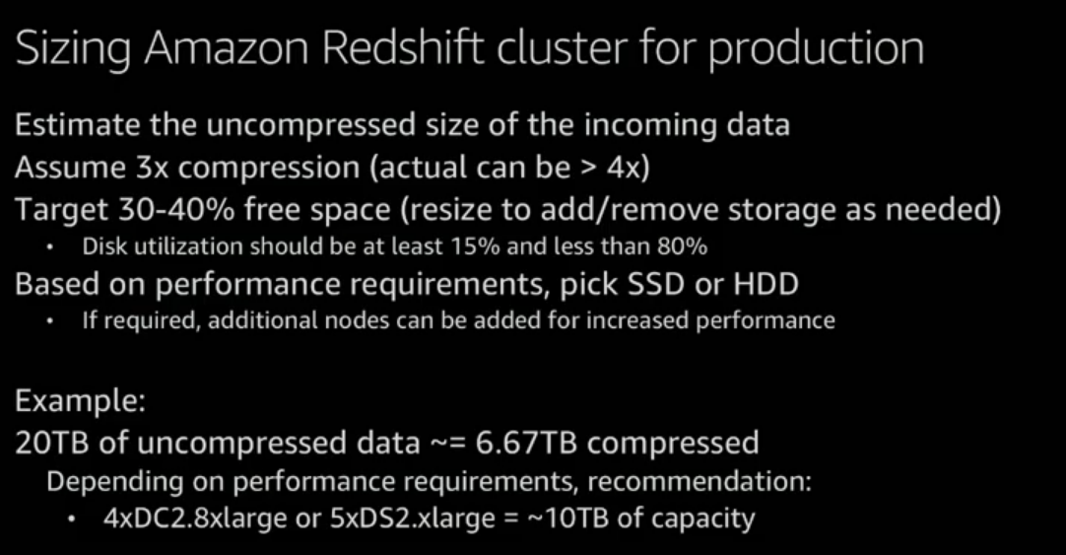

Slide 58
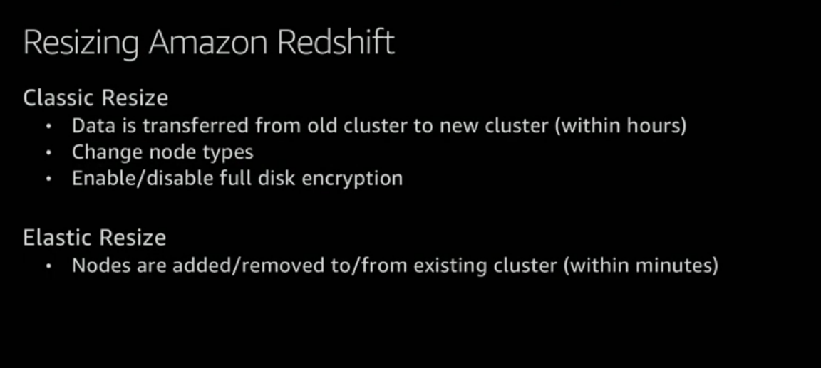

Slide 59
Elastic resize is a new feature as of Nov 30 2K18
Single Node clusters are okay for dev and testing environments but for production we need multi-node clusters.

Slide 60
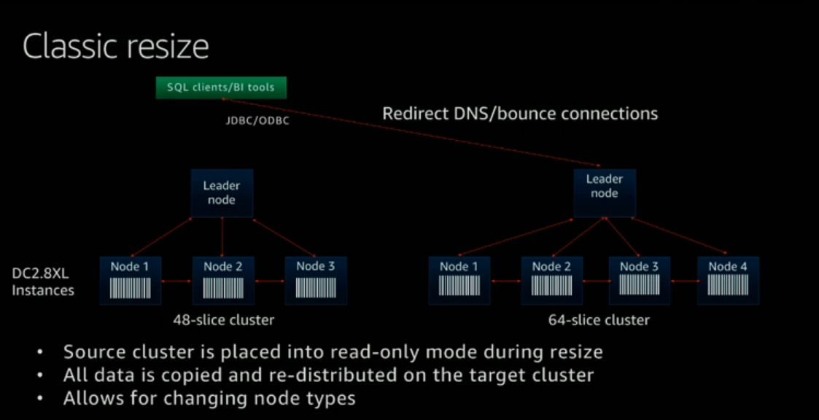

Slide 61
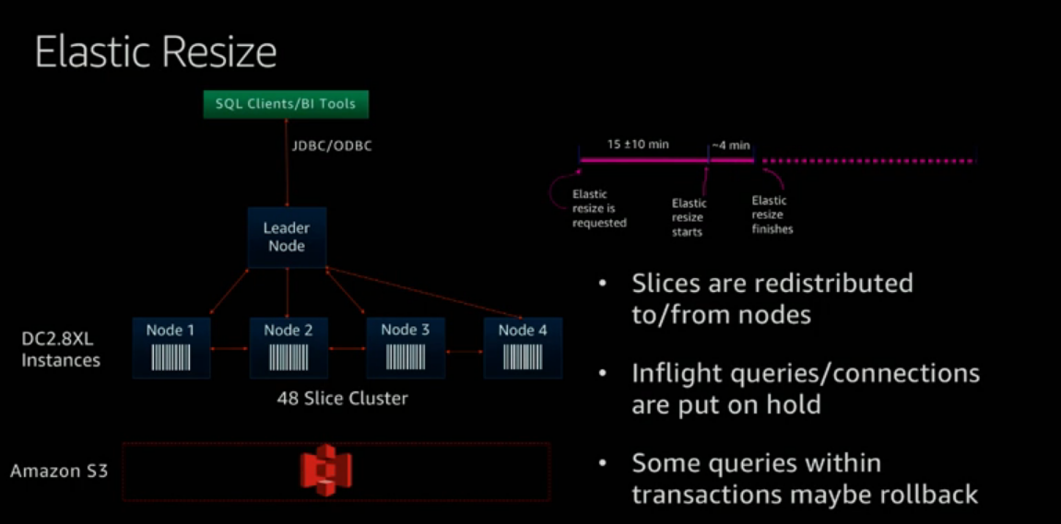

Slide 62
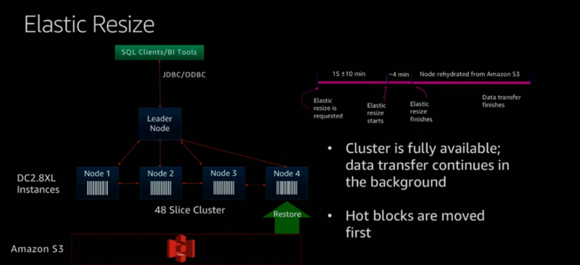

Slide 63
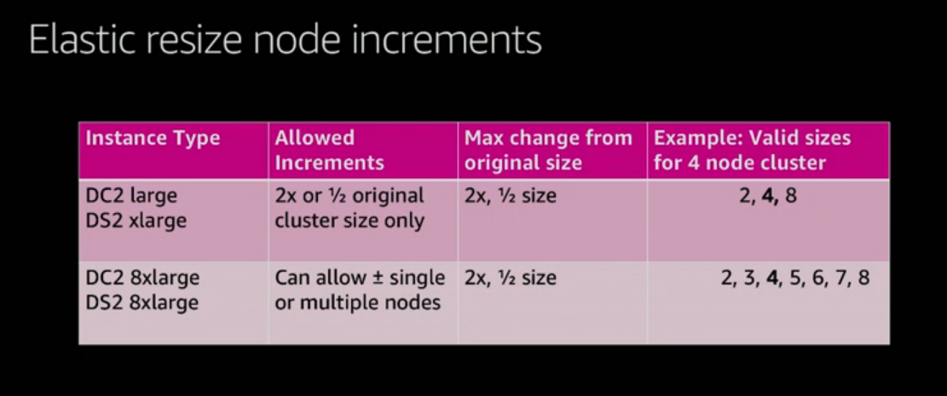

Slide 64
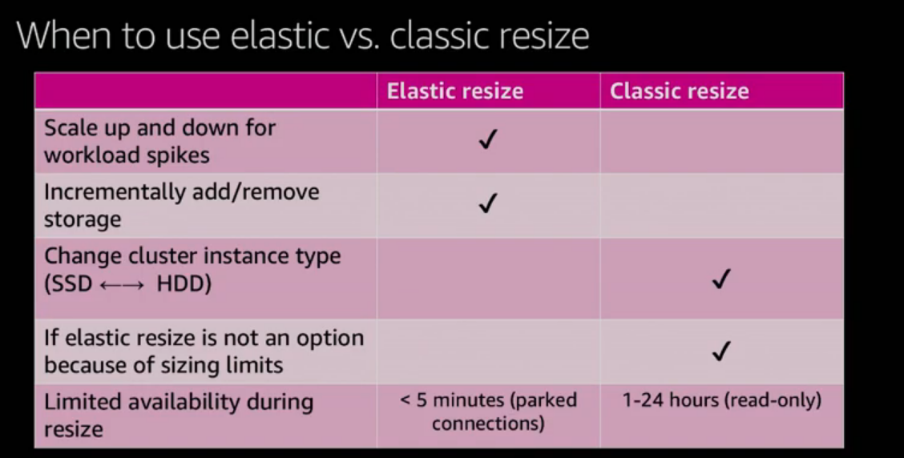

Slide 65
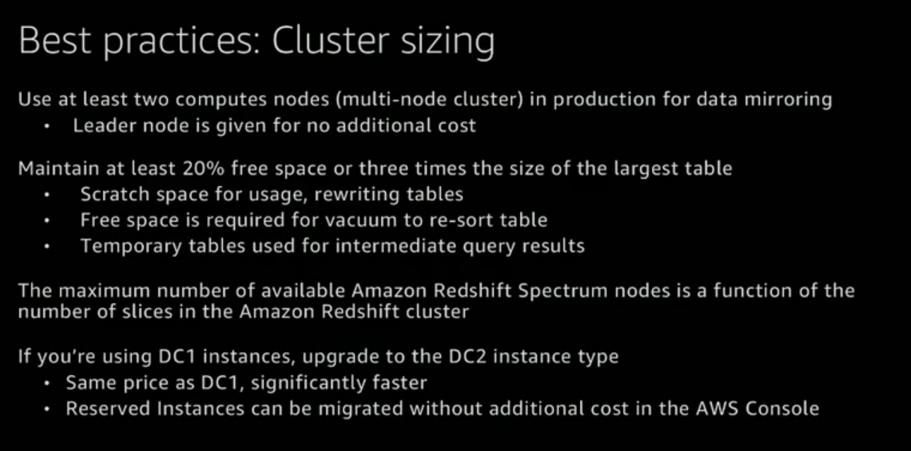

Slide 66
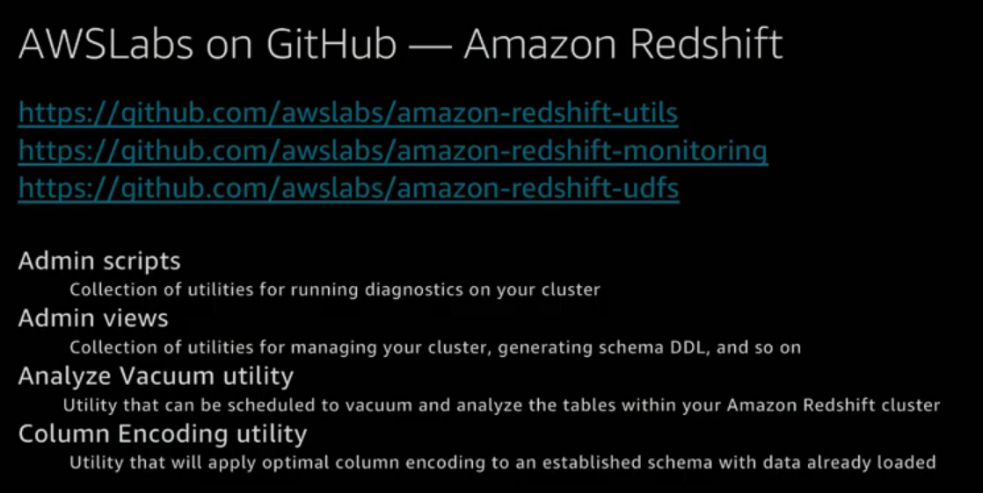

Slide 67
